Slide 1
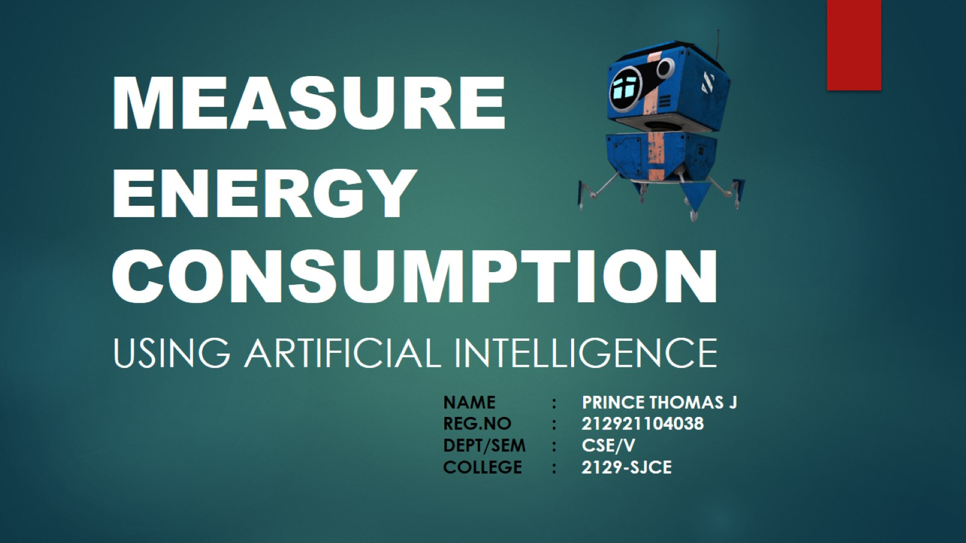
MEASURE ENERGY CONSUMPTION

Slide 2
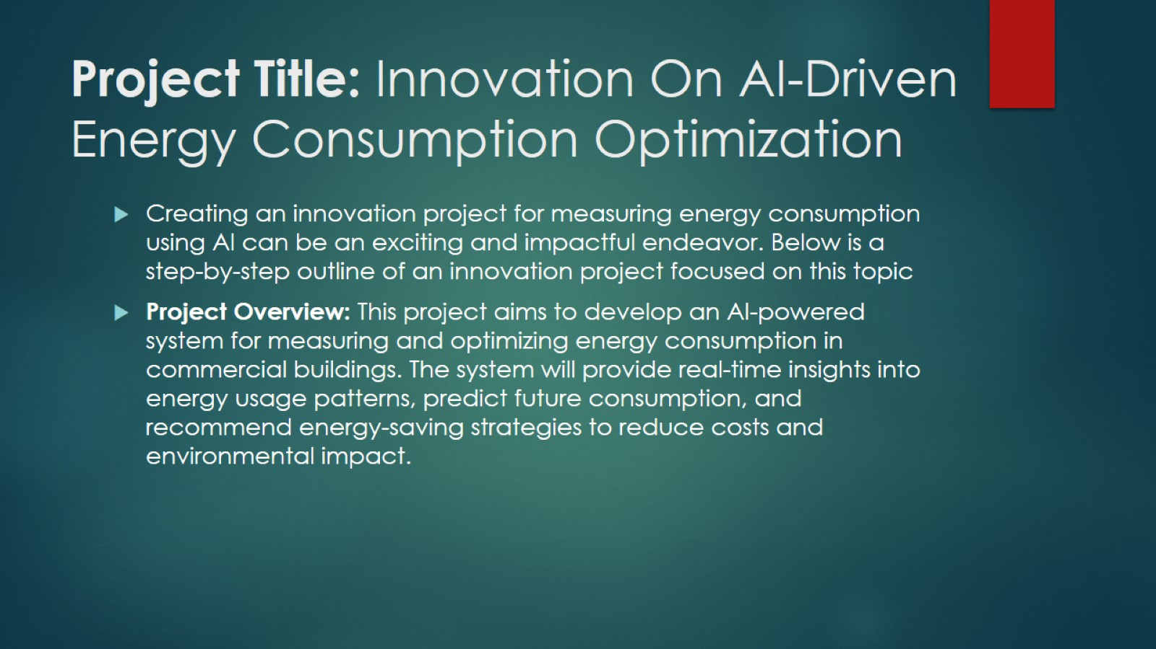
Project Title: Innovation On AI-Driven Energy Consumption Optimization

Slide 3
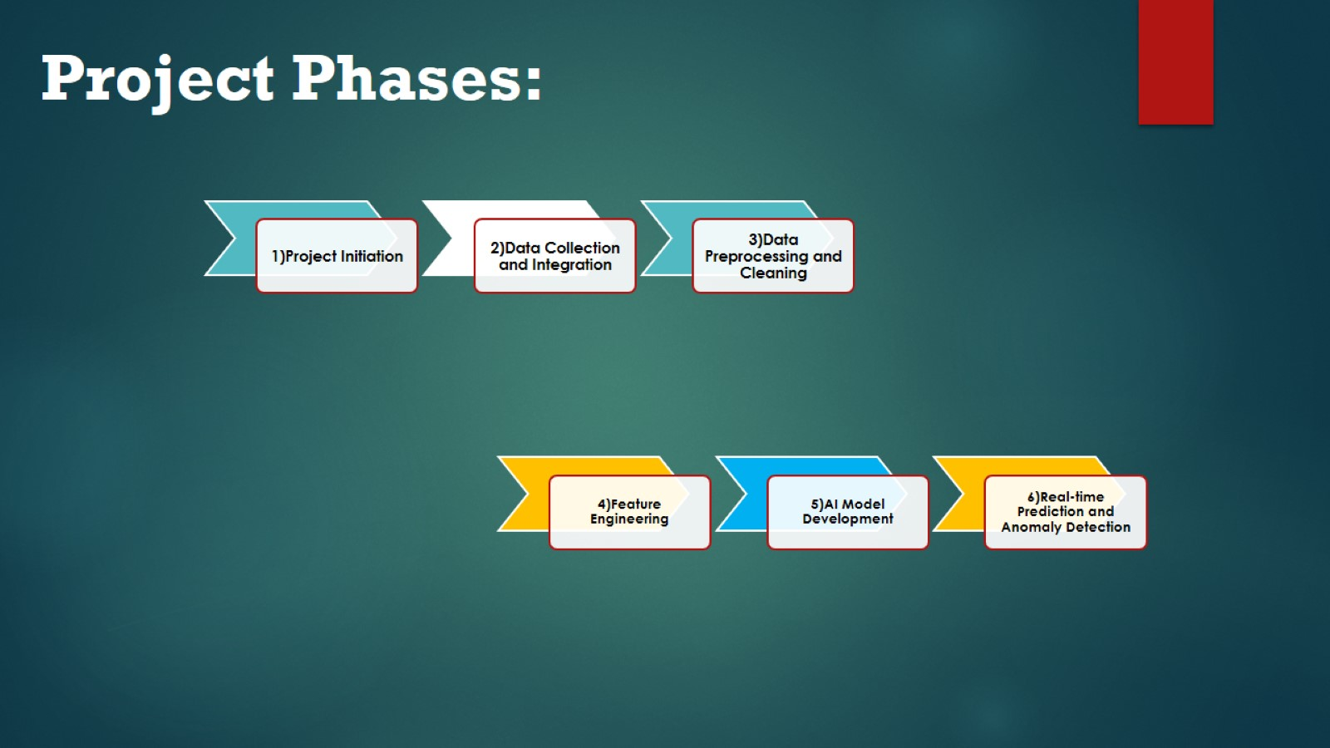

Slide 4
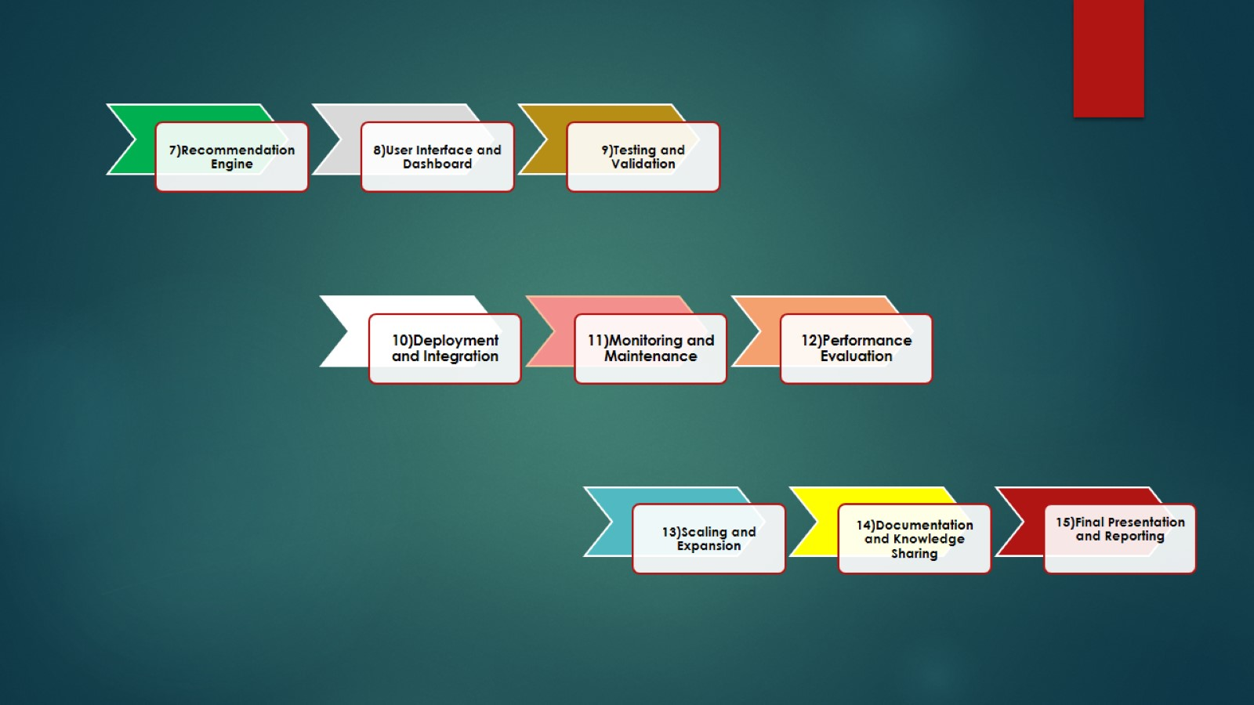

Slide 5
